Slide 1


De pie Sobre los Hombros de Gigantes ... a Salvo
Standing on the Shoulders of Giants… Safely
Mike Hansen
DevOpsDays Bogota
Notes:
Ya casi terminamos
Gracias por darme la bienvenida a tu hermoso

Slide 2
Este es el traductor de Google y estoy jugando con Mike. Piensa que esto dice algo completamente diferente. No se lo digas.
Notes:
Using google translate

Slide 3
Mejor software, más rápido. El Resultado Final de DevOps
Notes:
Better software, faster… that is the ultimate outcome we are seeking with DevOps. This why we are all here.

Slide 4
Sobre mi
Jefe de desarrollo de producto en Sonatype
https://www.linkedin.com/in/mikeahansen/
@mah0526

Slide 5




Creators of Software Supply Chain Automation Solutions
Creators of Nexus,
the most used Repository Manager
Mejor software, más rápido
Creators and stewards of
Central Repository, largest Java OSS repo
2019
Creators of
Apache Maven, most widely used build tool
Mejor software, más rápido
2001

Slide 6

Si lo he visto más lejos es pararse sobre los hombros de gigantes.
Sir Isaac Newton
ad 1675

Slide 7

Interrumpido
Custom Code
Notes:
20 years ago, we wrote just about everything in our apps.

Slide 8
Custom Code
Interrumpido
Open Source
Notes:
Today, 80-90% of it is often open source.
Standing on numerous open source giants
many of whom are standing on other open source giants.
focus on delivering the unique value
But a lot is hidden from view.

Slide 9

Comenzando un movimiento
Notes:
Maven creates building blocks.
Technology that led to the transformation of our application stacks
Reuse of other people’s code became easier than ever.

Slide 10
Comenzando un movimiento
Notes:
Maven was followed by numerous other ecosystems
The world of development forever changed
The benefits are extraordinary
So are the dangers.

Slide 11
>2,000,000 Proyectos OSS
grandes números
Notes:
This month we crossed 2,000,000

Slide 12
>2,000,000 Proyectos OSS
>20,000 Nuevas versiones publicadas diariamente.
grandes números
Notes:
20,000 new versions are published every day

Slide 13
>2,000,000 Proyectos OSS
>20,000 Nuevas versiones publicadas diariamente.
¡ >2,000 Nuevos proyectos cada día!
grandes números
Notes:
2,000 new kinds of software every day
Amazing

Slide 14
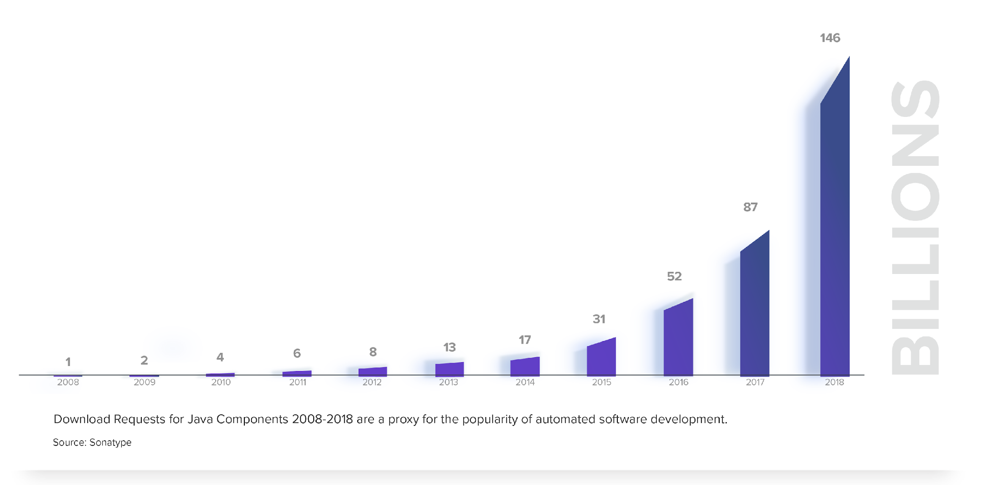
Tráfico Maven Central
La automatización acelera todo
Notes:
Automation drives consumption

Slide 15

> 1 billón de descargas OSS diarias
Enorme consumo
Notes:
A billion downloads a day

Slide 16
> 1 billón de descargas OSS diarias
Esto fue hace unos pocos millones no hace mucho
Enorme consumo
Notes:
More open source was consumed since I came up on stage then was consumed in an entire day about 10 years back

Slide 17


Calidad
Con muchos globos oculares, todos los defectos son superficiales.
Notes:
Many eyeballs hypothesis
IF those eyeballs are looking in the right places.
Lot of very high-quality open source software
But a lot of it has problems
Thankfully, a lot more security eyeballs are now looking making security issues a bit shallower.

Slide 18
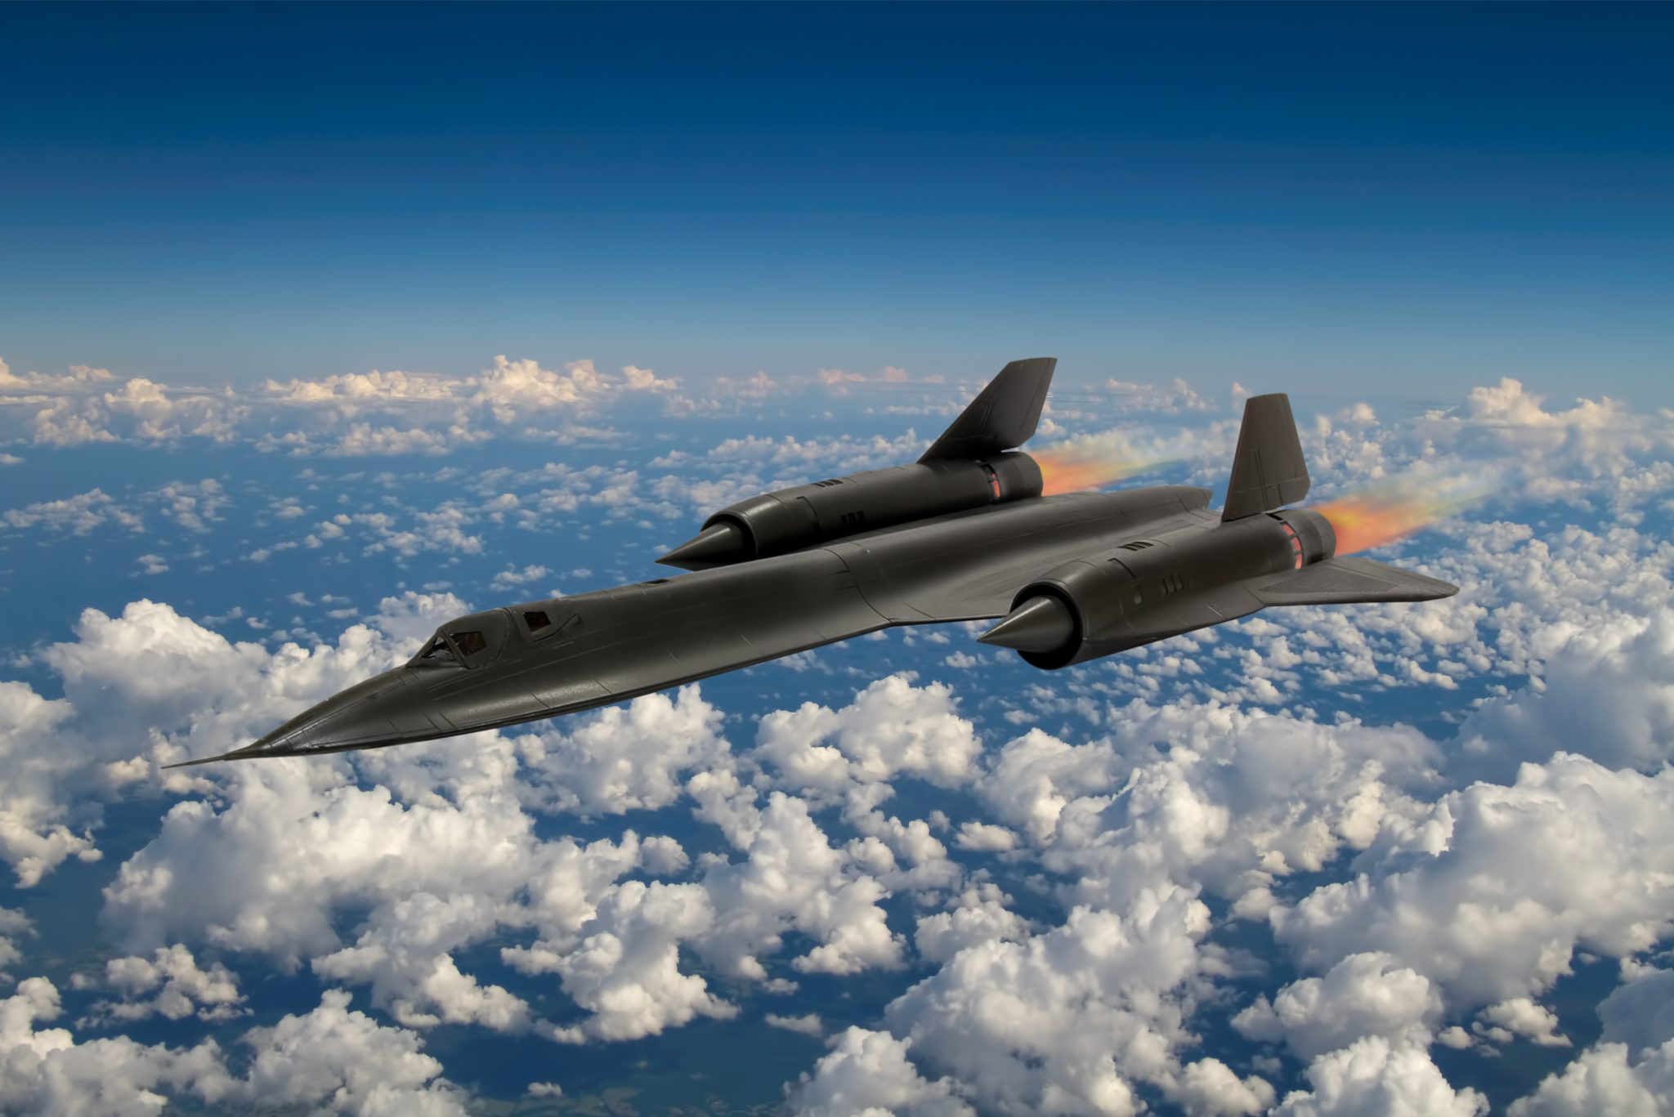
Más rápido
Notes:
Effective use of open source -> specialization
Why write a logging framework?

Slide 19

Los fuertes sobreviven
Notes:
Not leveraging open source effectively leads to corporate natural selection
Development costs and speed to market would suffer.
No longer competitive

Slide 20
Aquí para quedarse
OSS
Notes:
Open source is here to stay and that’s great. It’s only going to get better
Need to use if effectively if we are going to develop better software, faster.

Slide 21




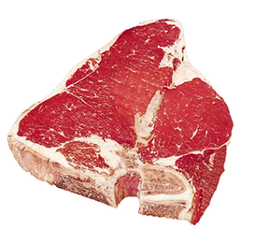
Su software tiene una cadena de suministro
We are not the first industry to face
a supply chain challenge
Notes:
When 80%-90% of your application stack is written by a bunch of other people, you have a supply chain. Often not a very well understood one.

Slide 22


Empeora con el tiempo
Todo el software envejece como la leche, no el vino
Notes:
New vulnerabilities and defects are continually discovered. Like milk, software doesn’t get better, it effectively degrades over time.

Slide 23

March 7
Apache Struts releases updated version to address vulnerability
CVE-2017-5638
July 29
Breach is discovered by Equifax.
Divulgaciones de vulnerabilidad
5 Month Opportunity to Take Corrective Action
Probing Attacks
Large Scale Exploitation and Data Theft
Crisis Management
Mar
Apr
May
Jun
Jul
Aug
Sept
March 9
Equifax applications breached through Struts2 vulnerability
Sept 7
A new RCE vulnerability is announced and fixed.
CVE-2017-9805
Notes:
Probes early
Compromised for months
Catastrophic loss

Slide 24
Tiempo de exposición cae
Tiempo para responder antes de explotar
Source: Adapted from IBM X-Force / Analysis by Gartner Research (September 2016)
50
45
40
30
Average
Average Days to Exploit
20
15
10
0
2006
2007
2008
2009
2010
2011
2012
2013
2014
2015
2017
Year
Notes:
The time to active attacks has dropped significantly

Slide 25
Ataques maliciosos
Event-Stream
Notes:
CoPay wallet story

Slide 26
Acción
¿Qué podemos hacer?
Notes:
What can we do?

Slide 27
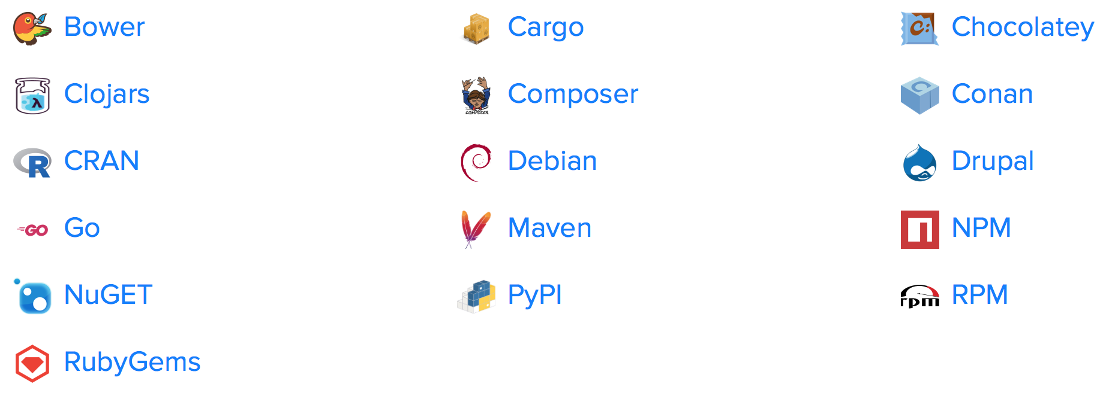
Saber qué OSS estás utilizando
https://ossindex.sonatype.org
Visibilidad gratis
Notes:
Get visibility
Start with free tools
OSS index
OWASP Dependency Check is also a good solution (uses our data).
Quickly highlight potential risks.
These are an ideal place to start, to assess risk

Slide 28
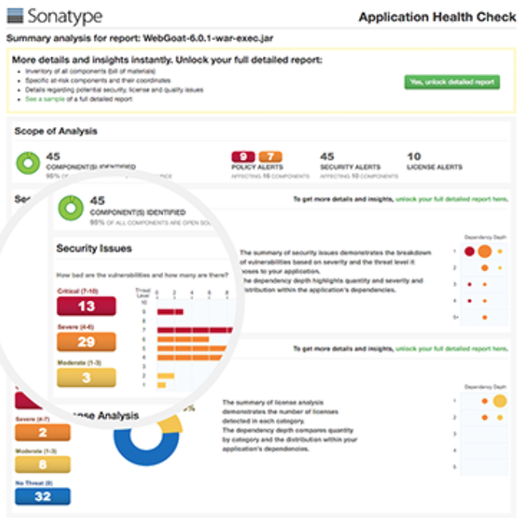
Nexus Vulnerability Scanner
Visibilidad gratis
https://www.sonatype.com/appscan
Notes:
NVS is another more in depth solution

Slide 29
Establecer un conjunto de reglas
Tomar el control
Notes:
Take control but getting some basic rules in place.
Understand risk, prioritize response, take action.

Slide 30
Higiene
Con visibilidad y reglas la higiene mejora
Notes:
As you get control you improve hygiene
With improved hygiene it is quite easy to prevent new problems
Keeps your software from aging like milk.

Slide 31
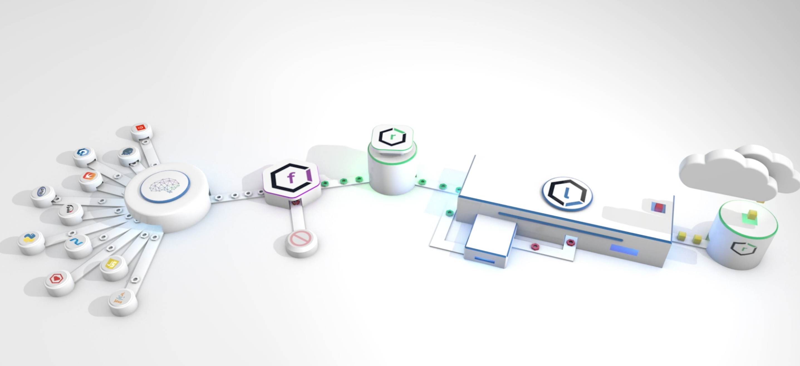
La plataforma Nexus
Automatización
Notes:
As you mature, automation can be used effectively
A requirement for scale
Doesn’t slow down development
It actually makes it faster

Slide 32
Gracias
¡ Mejor software, más rápido!

